Slide 1



Glassdoor Reviews Sentiment Analysis
View in Power BI
Last data refresh:
06/05/2022 23:55:40 UTC
Downloaded at:
06/05/2022 23:56:34 UTC

Slide 2
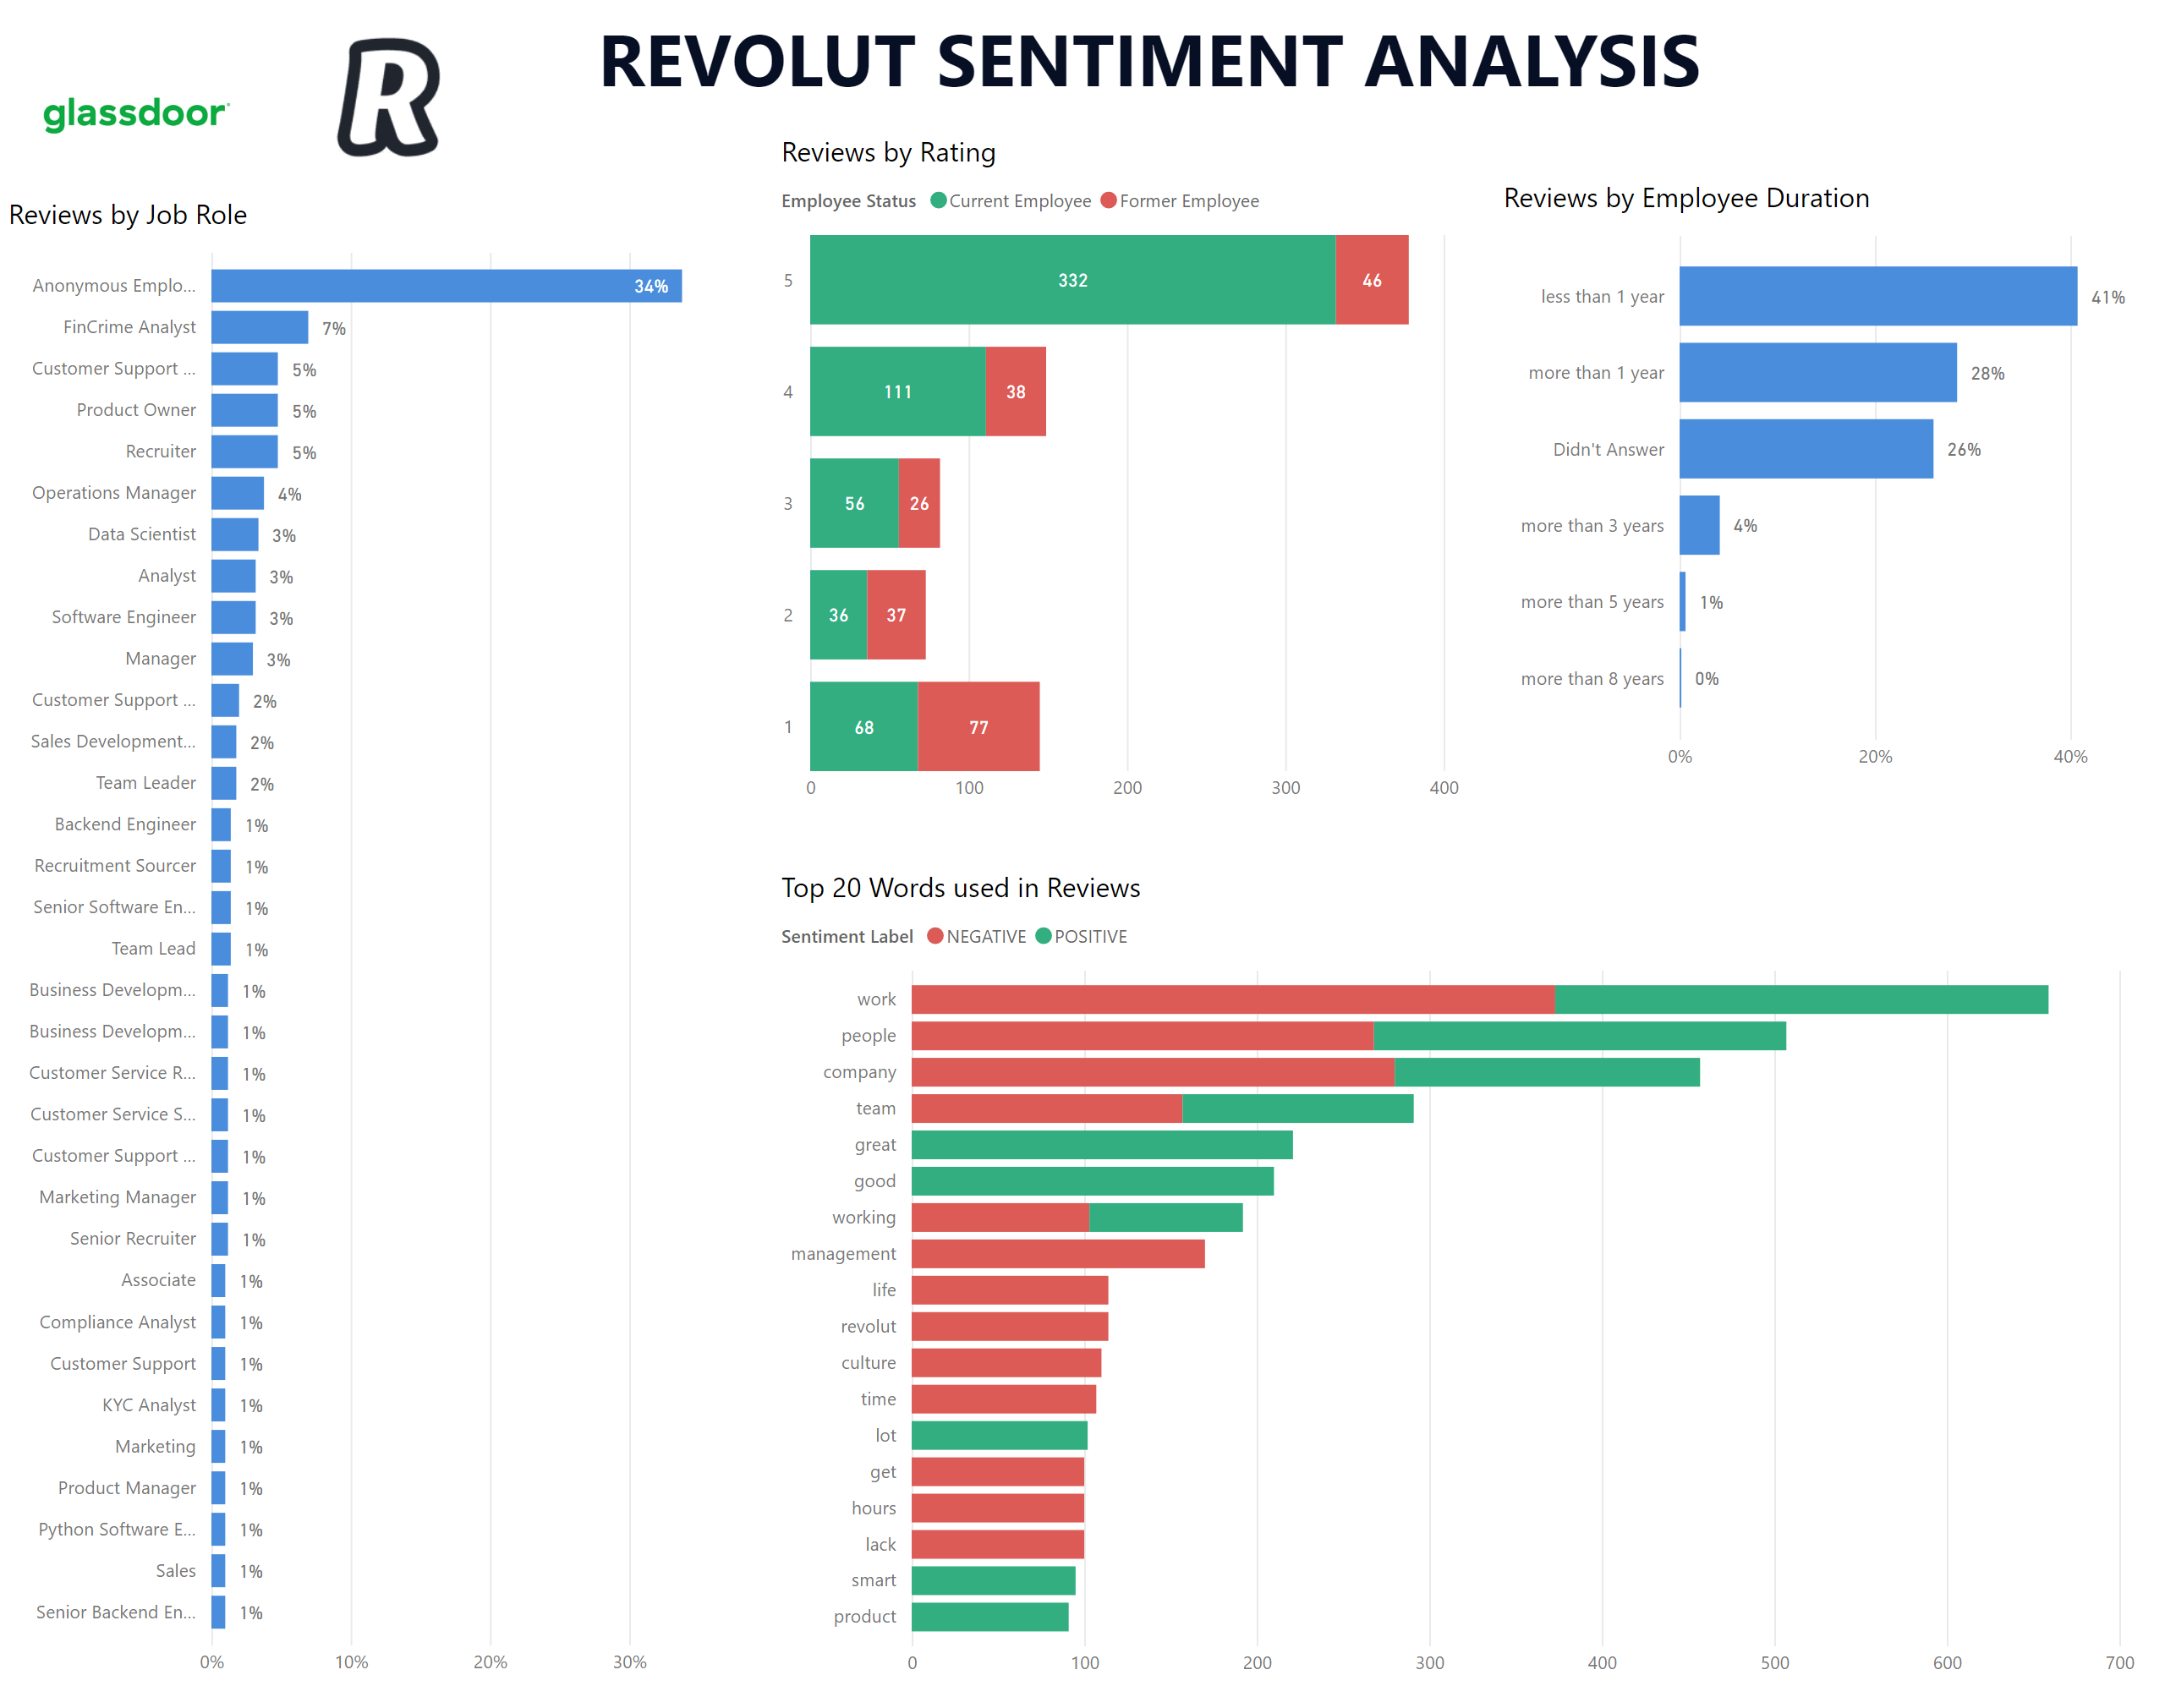
Page 1
Notes:
Reviews by Rating
No alt text provided
image
No alt text provided
image
No alt text provided
Reviews by Employee Duration
No alt text provided
textbox
No alt text provided
Top 20 Words used in Reviews
No alt text provided
Reviews by Job Role
No alt text provided

